Slide 1
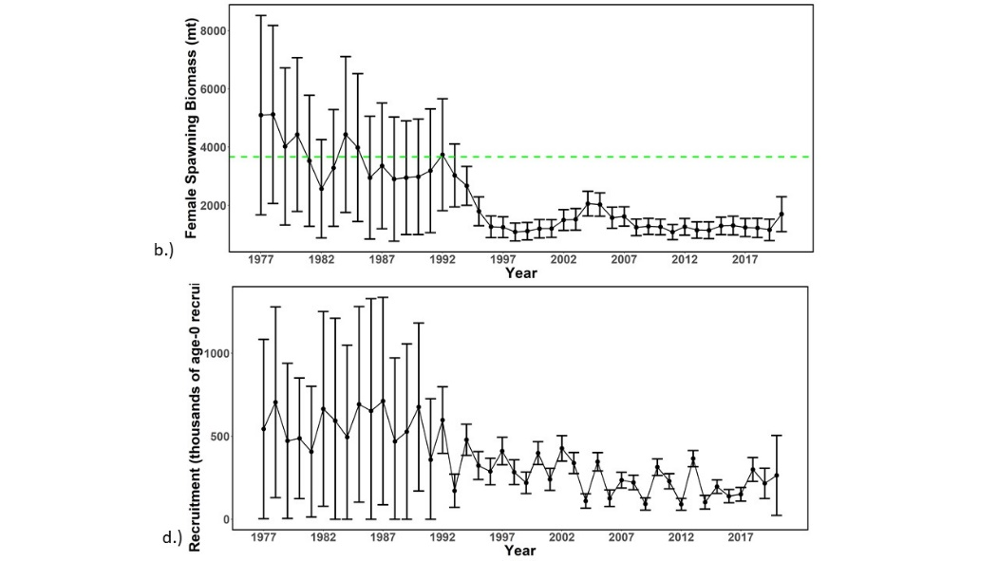

WCNPO Striped Marlin Rebuilding Plan Project
WCNPO
Striped Marlin 2023
Project Goals
Produce a robust management plan to rebuild the WCNPO striped marlin stock to the target biomass
Produce better science in less time using open science tools
Enhance reproducibility, collaboration and communication within PIFSC and among scientists and stakeholders
Automate workflow to produce harvest strategy forecasts using NOAA HTC or HPC systems
Target Biomass

Slide 2
Meeting Agenda 15-November-2023
Project Organization
Software Infrastructure
Projection Data Preparation
Base Projection Model Setup

Slide 3
Project Goals: Council Recommends Phased Reductions
181st CM March 2020
Recommended NMFS request the ISC Billfish Working Group to consider conducting stock projections incorporating scenarios of phased catch reductions
Recommended NMFS include any new projections with phased catch reductions in any proposal for North Pacific striped marlin to WCPFC17.
Utilize 15 year rebuilding horizon for fishery to adjust to reducing indirect catch
Reach target with 60% or more probability per projections
WCPFC17 proposal, wrap in ‘new’ future US catch levels into Amendment 8
Four ‘phases’ over the next 15 years

Slide 4
Project Goals: Produce Projections and Rebuilding Plan
Basis of rebuilding plan – 2021 USA proposal:
1) Set 20%SSB_{current,F=0} as a biomass rebuilding target based on WCPFC common LRP
2) Use a 15 year timeline
3) Require at least 60% probability of reaching target*
*60% probability of reaching target based on scientific advice, including stock projections

Slide 5
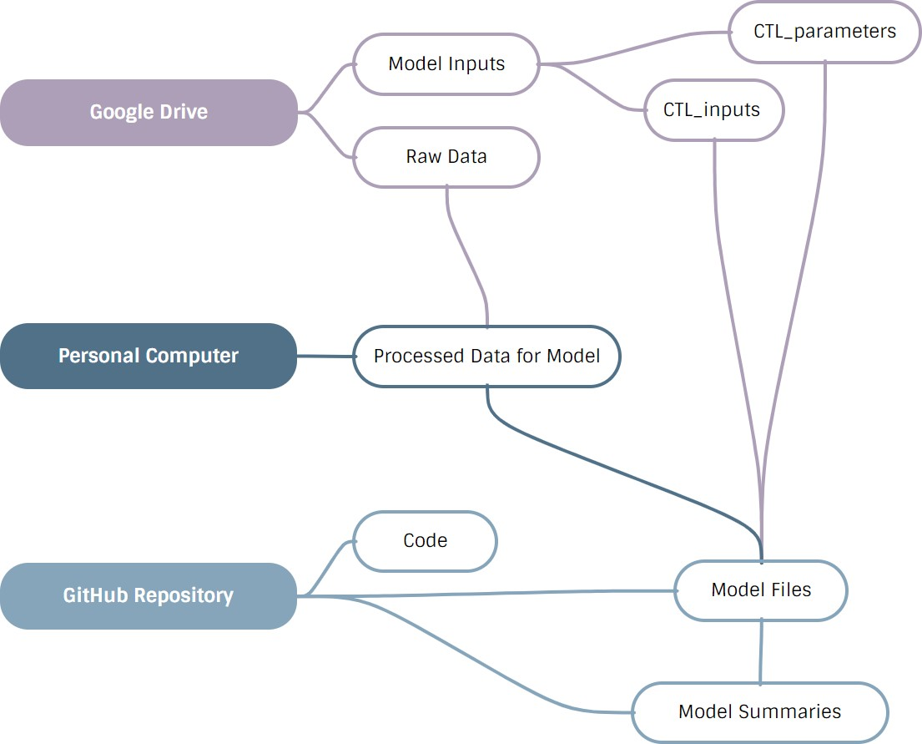
Project Organization

Slide 6
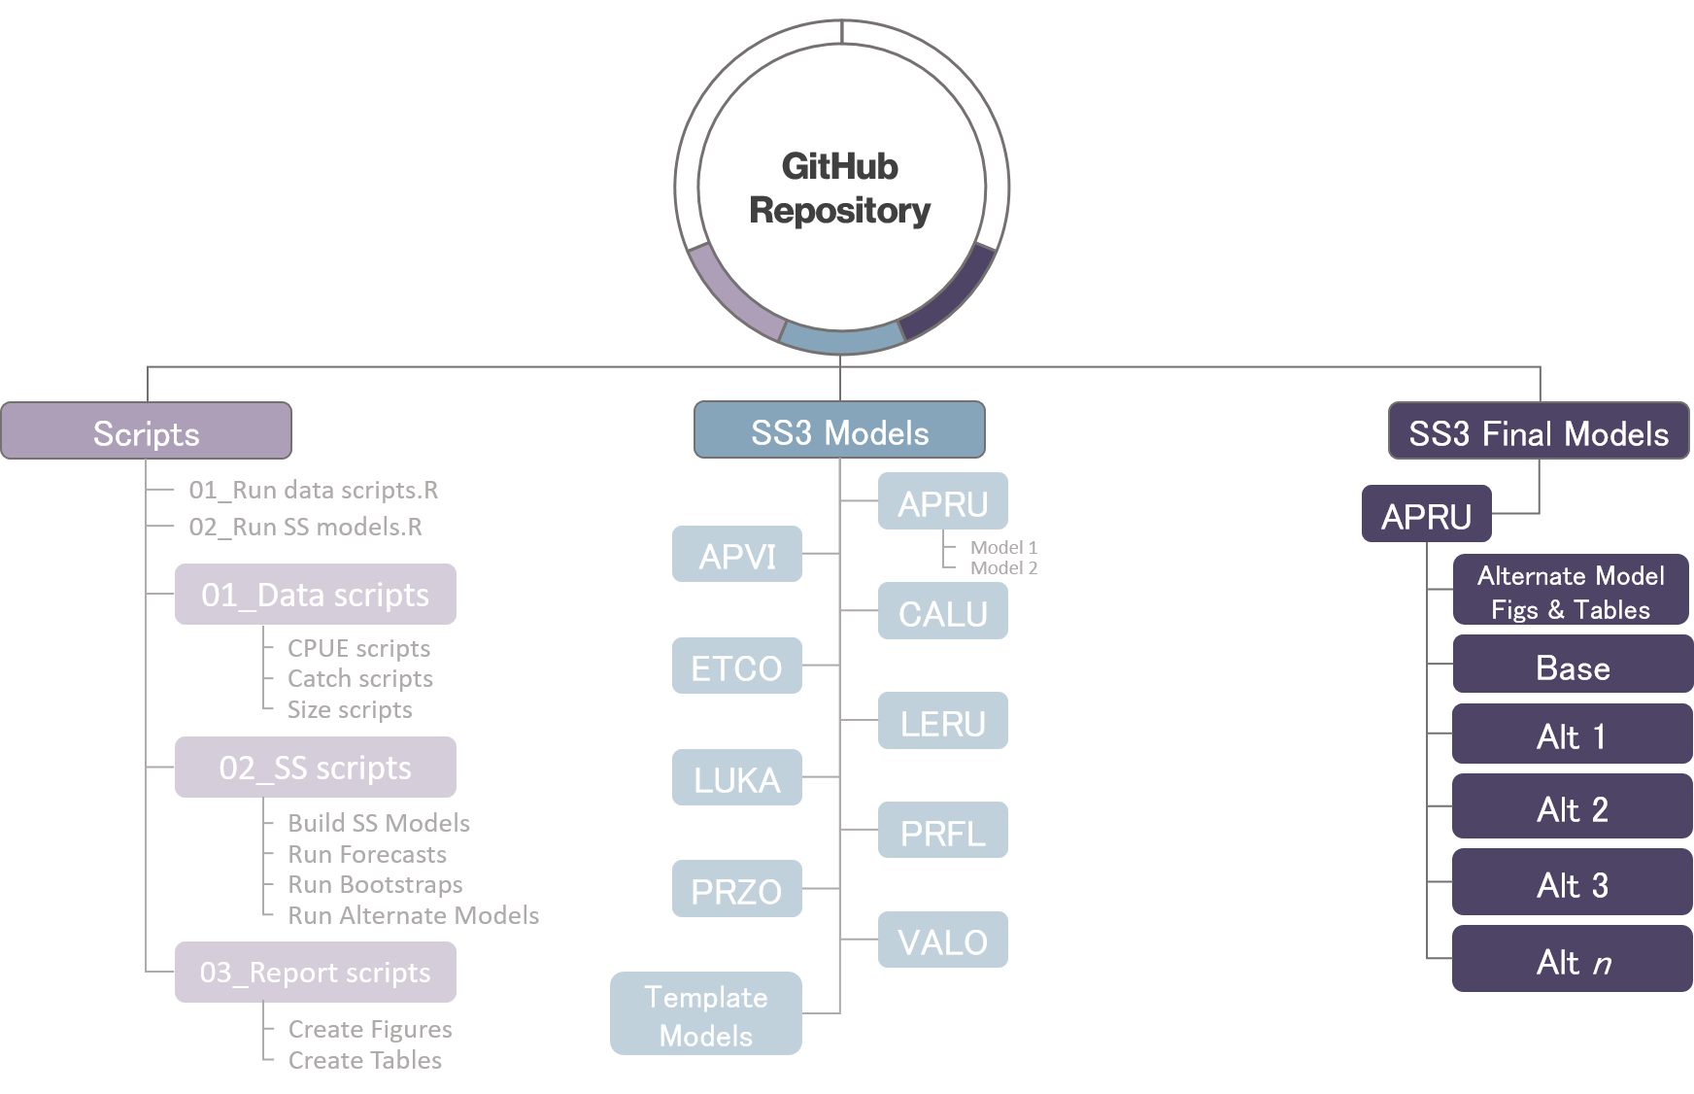
Software Infrastructure: GitHub Repositories

Slide 7
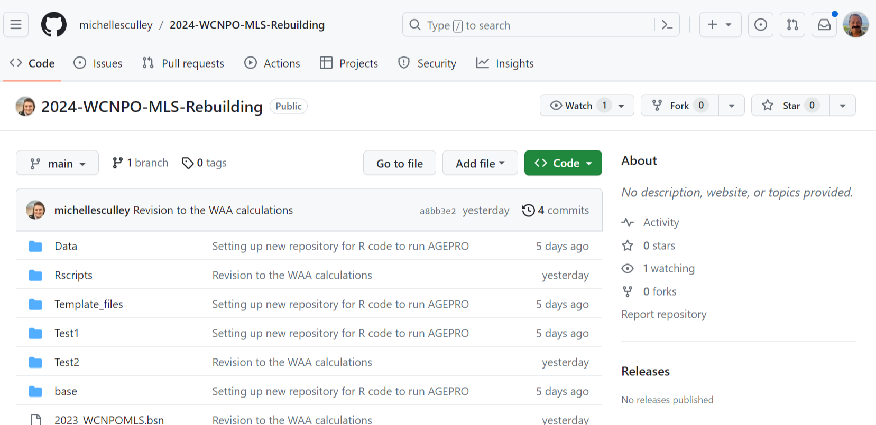
Software Infrastructure: 2024-WCNPO-MLS-Rebuilding Repository

Slide 8
Software Infrastructure: AGEPRO
Stochastic Stock-Recruitment Relationship
Distribution of Initial Population Abundance
Process Error for Population and Fishery Dynamics
Predict Probabilities of Achieving Biomass Target and Avoiding Overfishing Limit

Slide 9
Projection results for estimates of total allowable commerical catches of Deep7 Hawaiian bottomfish for fishing years 2012-2013 for probabilities P* of overfishing in under baseline catch Scenario II and CPUE Scenario I.

Slide 10
Software Infrastructure: Flowchart for AGEPRO
BEGIN
YES
DONE
WITH IC
LOOP?
SET INITIAL
POPULATION VECTOR
DONE
WITH SIM
LOOP?
NO
NO
END
YES
DONE
WITH TIME
LOOP?
COMPUTE LANDINGS
COMPUTE B_{S}
GENERATE RANDOM
RECRUITMENT
COMPUTE FUTURE
POPULATION VECTOR
FOR NEXT TIME PERIOD
COPY CURRENT B_{S}
TO
PREVIOUS B_{S}
COPY FUTURE
POPULATION VECTOR
TO CURRENT
RECORD THAT
SIMULATION IS
INFEASIBLE
NO
NO
SET VARIABLES THAT
VARY BY TIME PERIOD*
COMPUTE
CATCH AT AGE
IS
QUOTA
FEASIBLE
?
YES
*If Applicable

Slide 11
Base Model Setup: Distribution of Initial Stock Numbers

Slide 12
Base Model Setup: Annual Projection Timing
Start of
Year y
End of
Year y
Δ_{C}
Δ_{S}
Δ_{I}
0
Spawning
Catch
Survey
1
Movement

Slide 13
Base Model Setup: Quarterly Projection Timing Population Numbers at Age at Time τ* In Quarter t
Number
of Fish
τ_{t-1}
τ*
τ_{t}
Time
Start of
Season t
End of
Season t

Slide 14
Base Model Setup: Fishery selectivity mirroring by fleet in the 2023 Assessment
Objects are: Fleets (F(.)) and CPUE indices (S(.)) with representative size composition data Hyperedges are: Sets of fleets or indices mirrored to one selectivity in yellow shaded figures
Japanese DWLL
Fleet in Area 1 in Quarter 1
Japanese DWLL
Fleet in Area 3 in Quarter 1
F5
Japanese DWLL
Fleet in Area 2 in Quarter 1
Hawaii
Longline Fleet
F1
F9
F4
F14
F23
F6
F16
F22
F2
F20
F18
F8
F25
F24
F10
F17
F12
S2
F3
F11
F19
S1
F15
S3
S6
F13
F7
S5
S4
F21

Slide 15
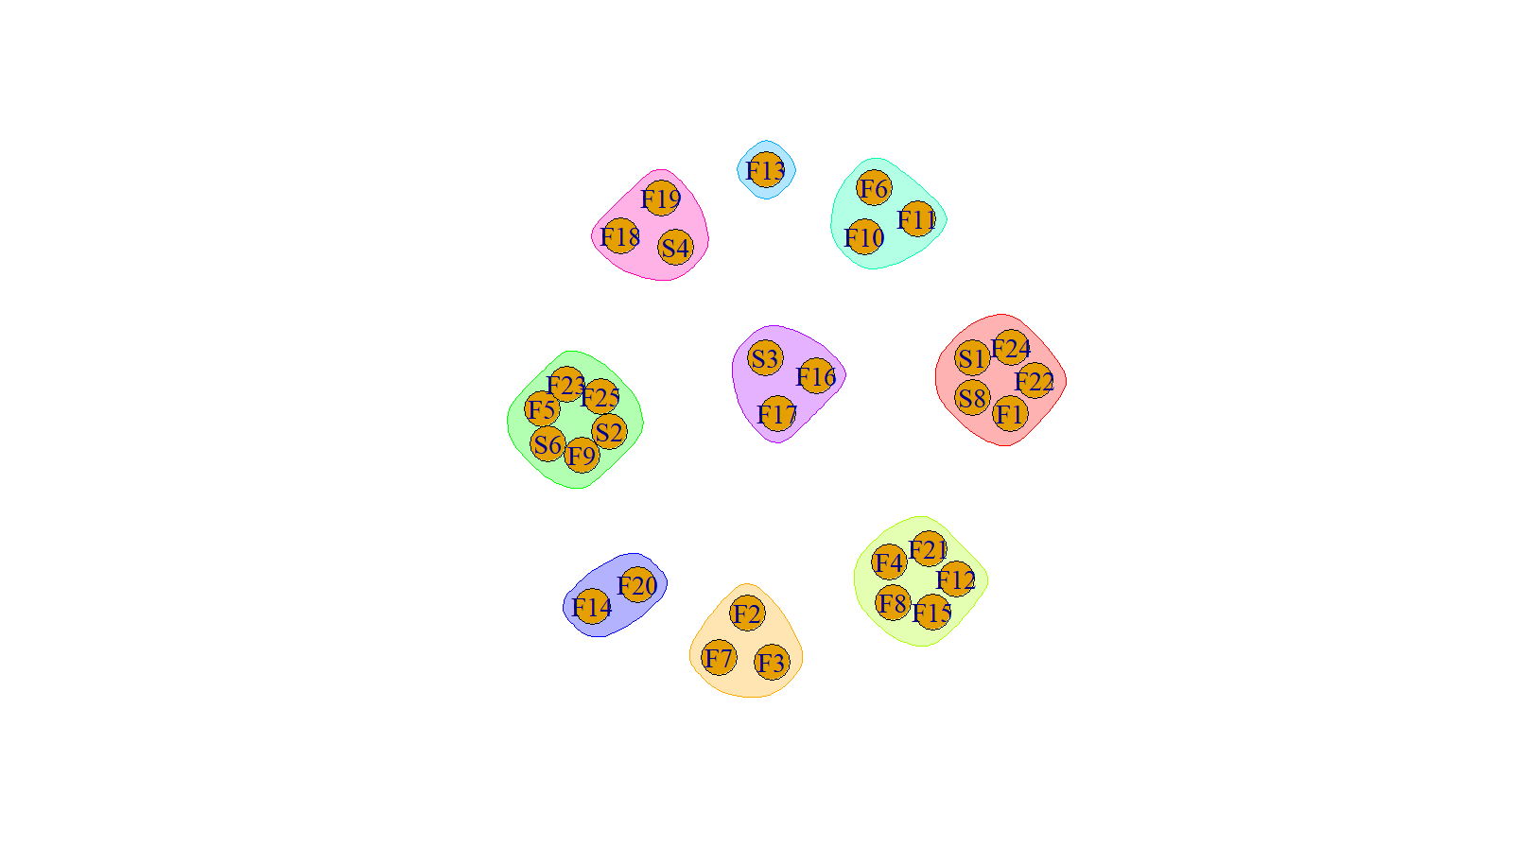
Base Model Setup: Fishery selectivity mirroring by fleet in 2023 assessment
Japanese
Driftnet Fleet In Quarters 1 & 4
Hypergraph visualization
Of the structural patterns
Of fishery selectivities
For 25 fishing fleets
And 6 CPUE indices
With 9 hyperedges
Taiwanese Distant
Water Longline
Fleet
Japanese DWLL
Fleet in Area 1 in Quarter 4
Japanese DWLL
Fleet in Area 1 in Quarter 1
Japanese DWLL
Fleet in Area 1 in Quarter 3
Hawaii
Longline Fleet
Japanese DWLL
Fleet in Area 3 in Quarter 1
Japanese
Driftnet Fleet
In Quarters 2 & 3
Japanese DWLL
Fleet in Area 2 in Quarter 1

Slide 16
Results: Phased vs Constant Catch Limits to Reach Target
~10% reduction for Avg 2015-2017 catch levels
First ‘phase’ would have a reduction no where near as severe as a constant total catch limit needed to reach the target
Stock will be re-assessed before conclusion of the first phase

Slide 17
Results: Phased vs Constant Catch Limits to End Overfishing
First phase would likely end overfishing, satisfying an MSA 304(i) requirement

Slide 18
Ensemble Model Setup for NOAA HTC/HPC Systems
Objects are: 15 individual models M(.) as members of region e₂ in a two-region ensemble model
Hyperedges are: Recruitment effects from climate change e₁, e₂, Natural mortality rates (n_{(.)}, red), and Selectivity types (s_{(.)}, blue)
Notation: Model M_{IJK} denotes
Climate impact type = I
Selectivity type = J
Natural Mortality type = K

Slide 19
How to Ensemble Efficiently?
High-throughput computing (HTC)
High-performance computing (HPC)
Set-up to handle running many jobs simultaneously
Ideal for running short, small, independent (embarrassingly parallel) jobs
Example: running 500 Stock Synthesis models with different input data or parameter settings
Can handle HTC workflows (in theory)
Can also handle long running, large, multi-processor jobs (true parallel processing)
Example: Fitting large spatiotemporal model in R using TMB required 128 CPU & 1TB RAM

Slide 20
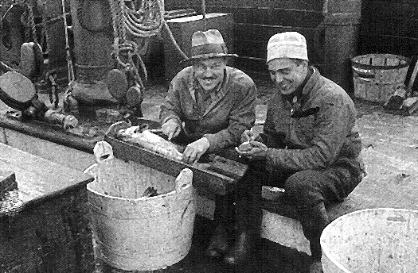
“Prediction is very difficult
…especially about the future”
Niels Bohr

Slide 22

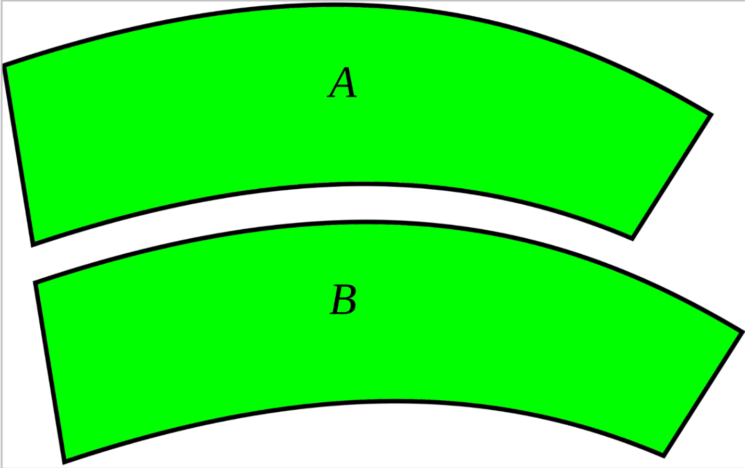
Conclusion
Hypergraphs provide a concise way to represent multiway relationships for modeling spatial systems
Hypergraphs with Vectorized Incidence Matrices can represent pairwise or multiway relationships in spatial assessment models for visualization, model specification and computer representation
Is A = B?
Seeing is not wholly an objective matter depending upon what there is to be seen, but is very considerably a subjective matter depending upon the eye that sees
~ Joseph Jastrow

